Slide 1
Support Ticket Classification Report
Team ID | Unique ID
6056652396519768348 | SIIL-TEAM-0003
Names | Roles
Harsh Mali | Leader
Aashay Tembhurne | Member
Anup Dakre | Member
Ayush Dubey | Member

Slide 2

Introduction
No product can be perfect for everyone, and some manufacturing mistakes can occur here and there.
A good company always listens to the reviews of the customers and work accordingly.
When a company is bombarded with reviews, it is tedious to go through each review and find issues.
We present you a ticket classification system that classifies the reviews to their corresponding ticket type.
This system classifies the tickets and helps the organization to reach out their customers.

Slide 3

Methodology
A support ticket dataset was used from Kaggle. It consists of parameters like issue subject, description of issue, product name, etc.
To train the model, parameters like issue description and issue subject was used.
The RNN model was used.
Finally, a web app was built using streamlit that takes input from user and provides an output.

Slide 4
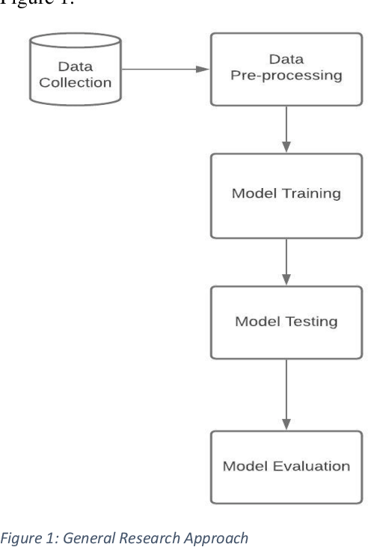
Process steps
Handled missing values, duplicate records, and incorrect data.
Convert data types and encode categorical variables. You may also normalize/standardize features.
Dataset was split for training and testing.
RNN model was selected and trained.
Model was evaluated by calculating accuracy, F1 score and recall.
Model is deployed via streamlit.

Slide 5
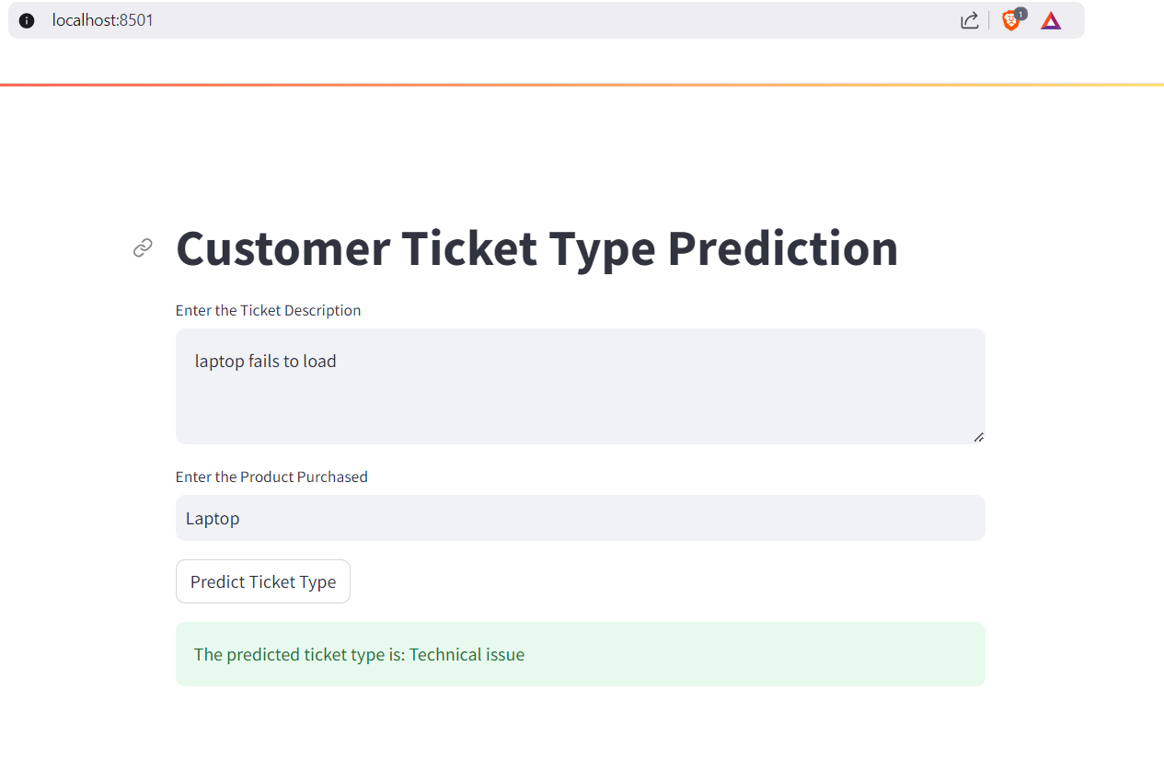
Results
Accuracy came out to be 76.35 percent after 100 epochs.
In the web app, the user inputs that they have issues with loading the laptop and the product “Laptop” is entered.
The model classifies the ticket type as “Technical Issue”.

Slide 6
Conclusions
We were able to classify the tickets based on the descriptions and subjects given.
The dataset used had a few missing values which handicapped the project. However, the values were filled so that the model could be built.
More improvements could be made with the availability of high-quality dataset.
Furthermore, a high-quality dataset will considerably improve the accuracy for the model.
Moreover, different models could be used and assessed for maximal performance and accurate classification,

Slide 7
References
AI-based Classification of Customer Support Tickets: State of the Art and Implementation with AutoML.
Support Ticket Classification using TF-IDF Vectorization.
Support Ticket Classification Using NLP.

Slide 8
THANK YOU!

